Slide 1
2018 Info6250 final presentation Fresh tomato website by blazor
Hanwen Guo, Gongdai liu

Slide 2
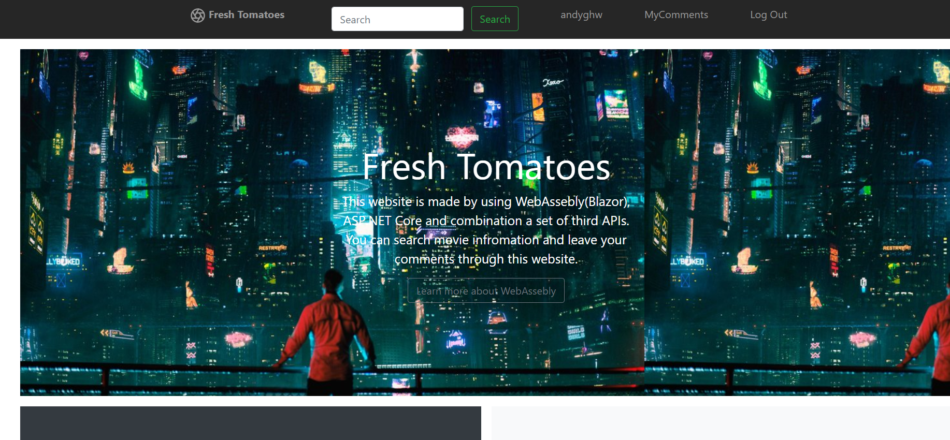
Fresh tomatoes
Login/Register
LinkedIn Login
Movies Search through IMDB API
Add or delete comments for movies
Locate user and search for nearby
theaters

Slide 3

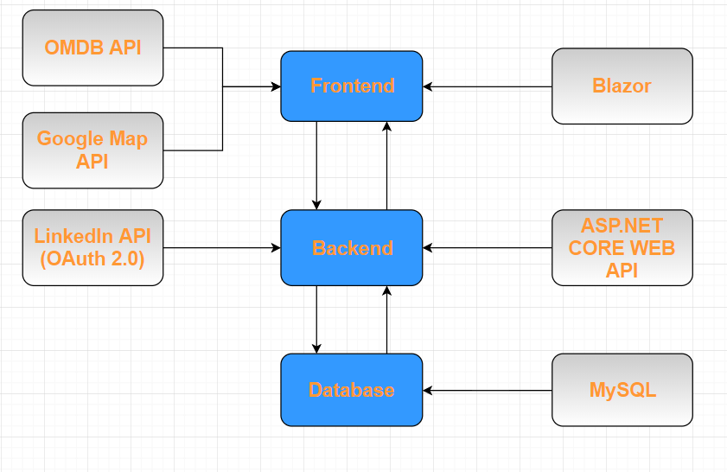
System structure

Slide 4
Database (Mysql)
Comments Table.
User Table

Slide 5
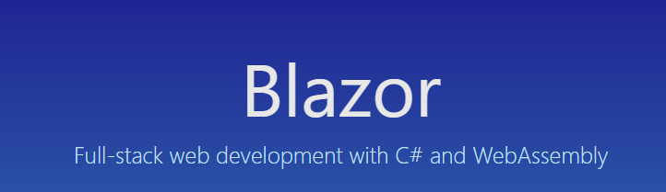
Front end

Slide 6
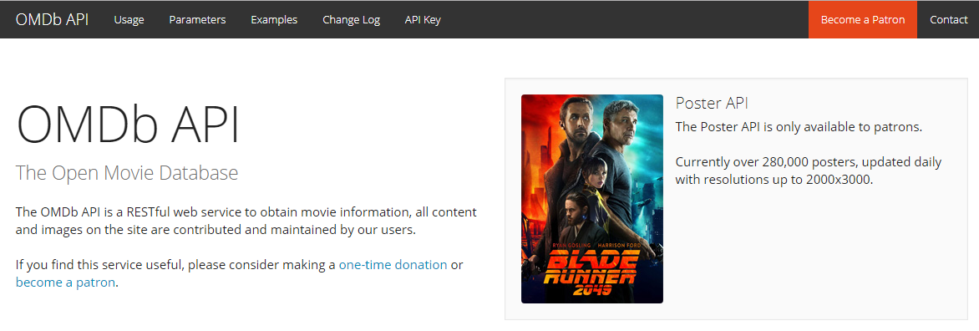
Omdb Api
The OMDb API is a RESTful web service to obtain movie information, all content and images on the site are contributed and maintained by our users.

Slide 7
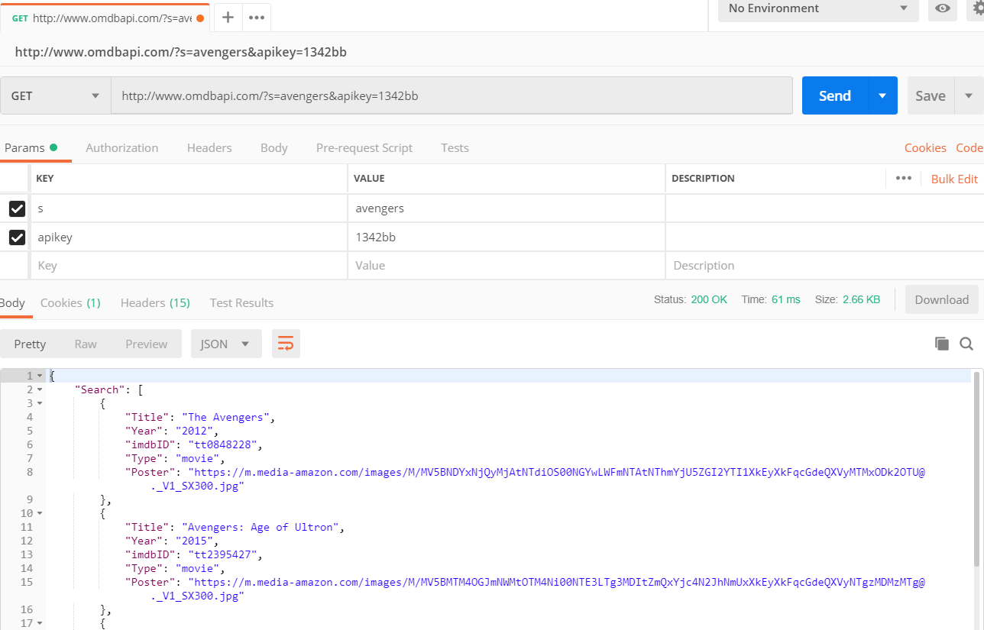
Omdb Api
To use OMDB API, you need first to apply for an Application Key through email.
Then, you are able to search movies by appending you key to the URL.

Slide 8
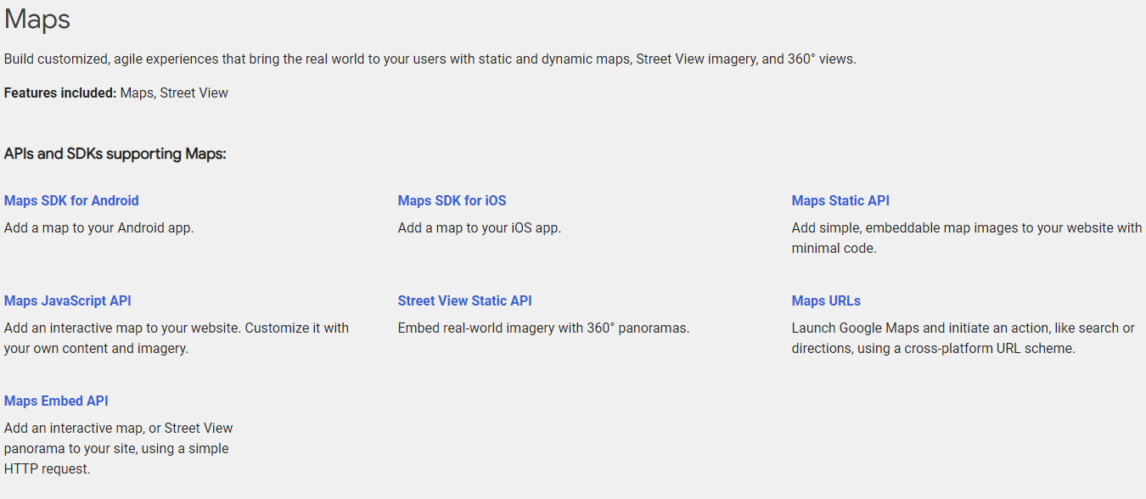
Google map api
To achieve the interactive function of Google Map, we chose Map JavaScript API

Slide 9
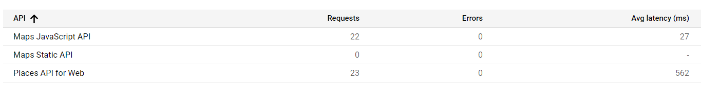
Google map api
Preparation
To use Google Map API, you need first to apply for a Google Cloud account and create your application while getting your Application Key.
Then you need to enable the Map JavaScript API in Google Cloud.

Slide 10
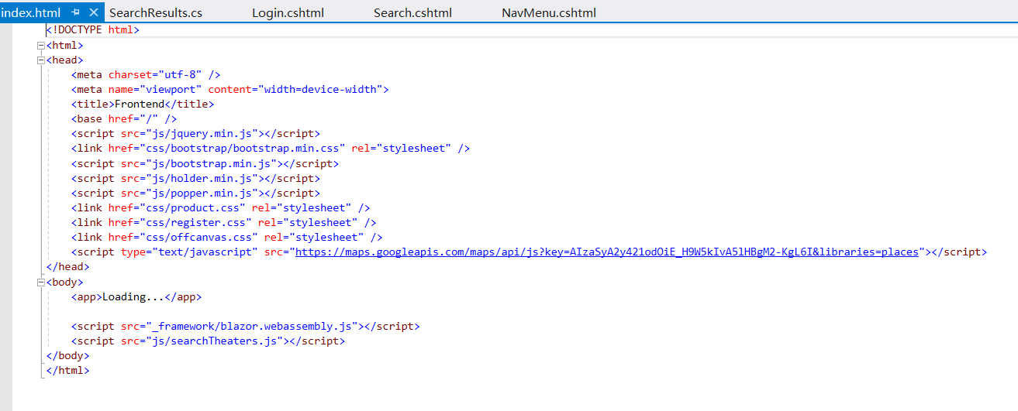
Google map api
Implement
Because this is a JavaScript Library, you need to import the library in you index.html page and create an responsive JS file to deal with the logic of Google Map.
Application Key
JS file to deal with the logic of Google Map

Slide 11

Back end

Slide 12
Back end (asp.net mvc)
Models:
Domain: Comment, Movie, User
Service: CommentService, UserService, MySqlConnector
Controllers
CommentController
UserController

Slide 13
Login/Register
The login and register function is achieved by executing SQL query through Web API to interact data with MySQL database.
Once login successfully, the basic information would be stored in the session of browser.

Slide 14

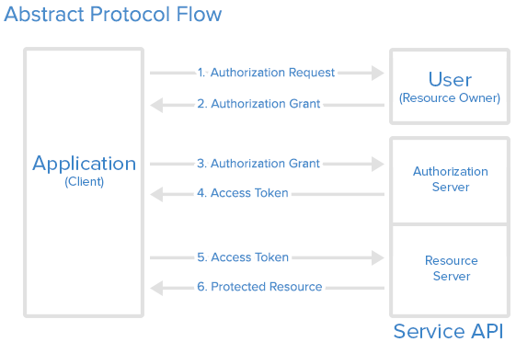
Linkedin login
We also implemented LinkedIn OAuth 2.0 to login our systems. In this case, users don’t have to register a new account any more.

Slide 15
comments
By calling Web API, users are able to view all comments of movies which are stored in databases.
Once a user login successfully, he is able to view all the comments that he wrote. And add or delete comments as well.

Slide 16
Project demonstration

